Slide 1
Chapter 7 Arrays: Lists and Tables

Slide 2
7.1 One-Dimensional Arrays
A one-dimensional array is a list of related data of the same data type, referenced by the same name.
An array is composed of elements, each of which is referenced by the array name and the element’s position in the array.

Slide 3
Array Basics
Array elements are stored in consecutive memory locations.
The position of an element in an array is called a subscript or an index.
Given an array named Scores[], in the element Scores[3], Scores is the array name and 3 is the subscript.
Each individual element of an array is referred to by writing the array name followed by its index number surrounded by brackets.
In most languages the first element of an array has index number 0
The first element of the array Scores would be referred to as Scores[0]
The second element is Scores[1]
The third is Scores[2]
Read these as “Scores sub 0”, “Scores sub 1”, and “Scores sub 2”

Slide 4
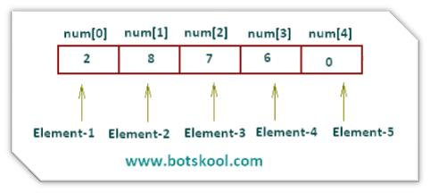
Array Basics

Slide 5
Entering Elements into an Array
If we wanted to input the final exam scores of a class of 25 students using an array named Scores which has 25 elements, we could use a loop as follows:
For (K = 0; K < 25; K++)
Write “Enter score: “
Input Scores[K]
End For
Note that, since the count (K) begins at 0, the test condition goes up to 24 (the loop ends when K = 25) to enter 25 elements.

Slide 6
Declaring Arrays
When an array is declared, the computer sets aside memory to store the values of the elements of the array.
Declaring an array means telling the computer what is the data type of the array and how many elements will be stored in it.
Pseudocode to declare arrays:
Declare Age[6] Of Integers
declares an array with 6 elements, all of which must be integers
Note: the first element
of an array has subscript 0
Address | Age[0] | Age[1] | Age[2] | Age[3] | Age[4] | Age[5]
Contents | 5 | 10 | 15 | 20 | 25 | 30

Slide 7
Filling (loading) an Array
Here is how to load an array with 52 values. The values represent a salesperson’s sales for each week of the year.
1. Declare WeeklySales[52] As Float
2. Declare K As Integer
3. For (K = 0; K <= 51; K++)
4. Write “Enter sales for week #” + (K + 1)
5. Input WeeklySales[K]
6. End For
Note that the sales for Week 1 correspond to the element WeeklySales[0] and the sales for Week 52 correspond to the element WeeklySales[51].

Slide 8
Example: Rainfall Amounts
1 Declare Rain[12], Sum, Average As Float
2 Declare K As Integer
3 Set Sum = 0
4 For (K = 0; K < 12; K++)
5 Write “Enter rainfall for month “ + (K + 1)
6 Input Rain[K]
7 Set Sum = Sum + Rain[K]
8 End For
9 Set Average = Sum/12
10 For (K = 0; K < 12; K++)
11 Write “Rainfall for Month “ + (K + 1) + “ is “ + Rain[K]
12 End For
13 Write “The average monthly rainfall is “ + Average

Slide 9
7.2 Parallel Arrays
Parallel arrays are arrays of the same size in which elements with the same subscript are related.
They can be used when array variables are related to each other by position or subscript.
The data in each array must be loaded in the correct order.
Example: Given: arrays NumberGrade and LetterGrade, each element of NumberGrade is related to an element in LetterGrade by the position in the array.
NumberGrade[]: 90 80 70 60 50
LetterGrade[]: “A” ”B” ”C” ”D” ”F”

Slide 10
Example: Use Parallel Arrays to Find the Best Salesman
1 Declare Names[100] As String
2 Declare Sales[100] As Float
3 Set Max = 0
4 Set K = 0
5 Write “Enter a salesperson’s name and monthly sales (*, 0 when done).”
7 Input Names[K]
8 Input Sales[K]
9 While Names[K] != “*”
10 If Sales[K] > Max Then
11 Set Index = K
12 Set Max = Sales[Index]
13 End If
14 Set K = K + 1
15 Write “Enter name and sales (enter *, 0 when done).”
16 Input Names[K]
17 Input Sales[K]
18 End While
19 Write “Maximum sales for the month: “ + Max
20 Write “Salesperson: “ + Names[Index]

Slide 11
Why Use Arrays?
Arrays reduce the number of variable names in the program.
Sales[K] versus Sales1, Sales2,... SalesN
Arrays improve efficiency by allowing data to be read into the program once but processed as many times as necessary.
Arrays increase the flexibility of the program.
Arrays reduce the number of If-Then statements needed in selection processing.
If Sales[K] Then
rather than
If Sales1 Then...
If Sales2 Then...
If Sales3 Then...

Slide 12
Arrays Save Time and Effort
1 Declare Sum, Count1, Count2, K As Integer
2 Declare Score, Average,
3 Declare Medieval[100] As Float
4 Set Sum = 0
5 Set Count1 = 0
6 Write “Enter a test score (or 999 to quit): “
7 Input Score
8 While Score != 999
9 Set Medieval[Count1] = Score
10 Set Count1 = Count1 + 1
11 Set Sum = Sum + Score
12 Write “Enter another score or 999 to quit: “
13 Input Score
14 End While
15 Set Average = Sum/Count1
16 Set Count2 = 0
17 Set K = 0
18 While K < Count1
19 If Medieval[K] > Average Then
20 Set Count2 = Count2 + 1
21 End If
22 Set K = K + 1
23 End While
24 Write “The average is:” + Average
25 Write “The number of scores above the average is: “ + Count2

Slide 13
Arrays Make Programming Easy and Concise
1 Declare Names[100] As String
2 Set Count = 0
3 Write “Enter a name. (Enter * to quit.)”
4 Input TempName
5 While TempName != “*”
6 Set Names[Count] = TempName
7 Set Count = Count + 1
8 Write “Enter a name. (Enter * to quit.)”
9 Input TempName
10 End While
11 Set K = Count – 1
12 While K >= 0
13 Write Names[K]
14 Set K = K – 1
15 End While

Slide 14
A Word About Databases
Databases consist of many tables that are linked in many ways.
A table can contain lists of related data.
A table is a group of parallel lists.
The information in the tables can be retrieved and processed for a large variety of purposes.
Often information from a table is stored as an array in a computer program for easier manipulation.

Slide 15
How Databases May Be Used
Imagine a database used by a company that provides and sells online computer games.
The company might have tables that store information about people who play each game.
To do market research:
Each table relating to one game might include players’ information like name, username, age, dates played, scores, and so on.
Research might only want to identify which age groups gravitate to which types of games.
By performing what is called a query, the owner can get this information quickly from the database.
Using the same tables in the database the company’s market research team can compile many types of information.
Queries can discover which games are played most often on weekends, during daytime hours, how many players of what ages, gender, or even location are most likely to play which types of games, and much more.

Slide 16
How Do Arrays Fit in?
The data retrieved from databases is processed and displayed through computer programs.
Often the required information from the tables is temporarily stored in parallel arrays.
It is manipulated, processed, and the results are output not directly from the database but from the arrays in the programs that are written by programmers.
While it is important to understand how to get and use information to load arrays directly from a user, understanding how to use arrays has a much more far-reaching purpose.

Slide 17
7.3 Strings As Arrays of Characters
Some programming languages do not contain a String data type.
Strings are implemented as arrays whose elements are characters.
In programming languages that contain the String data type, strings can be formed as arrays of characters.
To define a string as an array of characters, indicate the data type in the Declare statement.
The following statements:
Declare FirstName[15] As Character
Declare LastName[20] As Character
define the variables FirstName and LastName to be strings of at most, 15 and 20 characters, respectively.

Slide 18
Stringing Arrays Together
Declare String1[25] As Character
Declare String2[25] As Character
Declare String3[50] As Character
Write “Enter two character strings. “
Input String1
Input String2
Set String3 = String1 + String2
Write String3
Note: The + here means concatenation
If String1 = “Part” and String2 = “time”:
At the end of the program String3 = “Parttime”

Slide 19
String Length vs Array Size
The length of a string is the number of characters it contains.
In previous slide, the array String3 is declared as an array of 50 elements
But when “Parttime” is assigned to String3, only the first eight array elements are used
Thus, the length of the string “Parttime” is 8
Example:
Declare Str[10] As Character
Set Str = “HELLO!”
Write Length_Of(Str)
The result of this program would be 6

Slide 20
Using the Length_Of() Function to Validate Input
1 Declare Username[12] As Character
2 Declare Valid As Integer
3 Write “Enter your username. It must be at least 1 but no more than 12 characters:”
4 Input Username
5 Set Valid = Length_Of(Username)
6 While Valid < 1 OR Valid > 12
7 If Valid < 1 Then
8 Write “Username must contain at least 1 character. Please try again:”
9 Else
10 If Valid > 12 Then
11 Write “Username can’t be more than 12 characters. Try again:”
12 End If
13 Input Username
14 Set Valid = Length_Of(Username)
15 End While

Slide 21
Example: Using Character Arrays
The next example (pseudocode on next slide) allows the user to input a person’s full name (first name, then a space, then last name). It stores the initials of that person as characters, and displays the name in the following form: LastName, FirstName
This pseudocode uses three character arrays (strings): the input name as FullName, and the first and last names as FirstName and LastName.
It uses two character variables to store the initials, FirstInitial and LastInitial.
The trick to identifying which part of the input string is the first name and which part is the last name is to locate the blank space between them.
Assume that the following arrays and variables have been declared:
Character arrays: FullName[30], FirstName[15], LastName[15]
Character variables: FirstInitial, LastInitial
Integer variables: J, K, Count

Slide 22
Example: Using Character Arrays (continued)
1 Write “Enter a name, first name first, then last name:“
2 Input FullName
3 Set Count = 0
4 While FullName[Count] != “ “
5 Set FirstName[Count] = FullName[Count]
6 Set Count = Count + 1
7 End While
8 Set FirstInitial = FullName[0]
9 Set LastInitial = FullName[Count + 1]
10 Set J = 0
11 For (K = Count + 1; K <= Length_Of(FullName) – 1; K++)
12 Set LastName[J] = FullName[K]
13 Set J = J + 1
14 End For
15 Write LastName + “, “ + FirstName
16 Write “Your initials are “ + FirstInitial + LastInitial

Slide 23
7.4 Two-Dimensional Arrays
In a two-dimensional array, the value of an element depends on two factors instead of just one.
Sometimes it’s convenient to use arrays whose elements are determined by two factors.
Example: the records of the monthly sales for salespeople for a year:
Each salesperson has 12 numbers (one for each month’s sales) associated with him or her.
The value we look for would depend on which salesperson and which month is of interest.
In these cases, we use two-dimensional arrays.
Here is how to declare a two-dimensional array:
Declare Profit[12, 24] As Integer

Slide 24
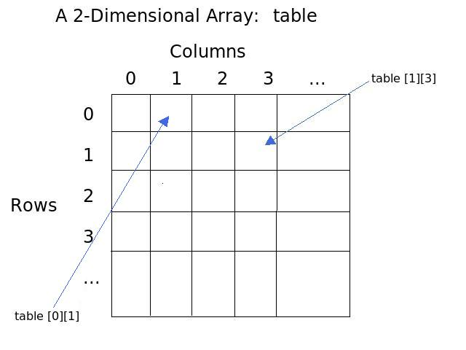
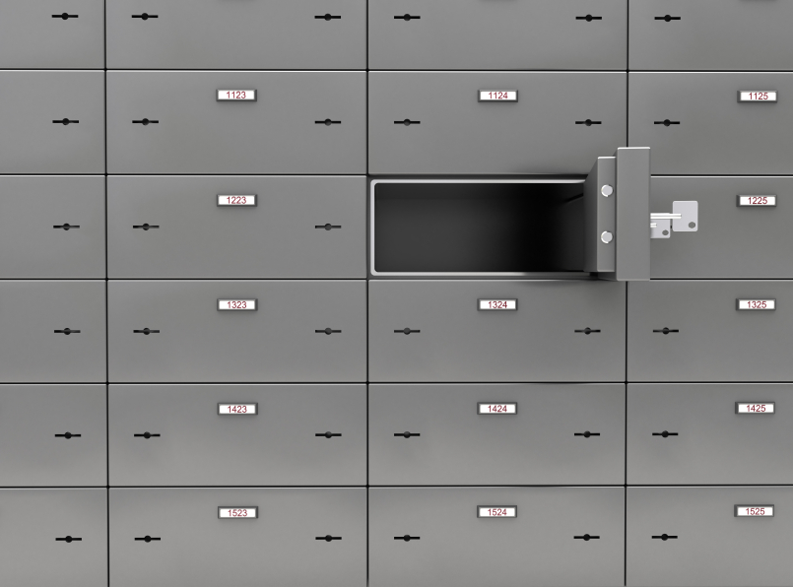
7.4 Two-Dimensional Arrays

Slide 25
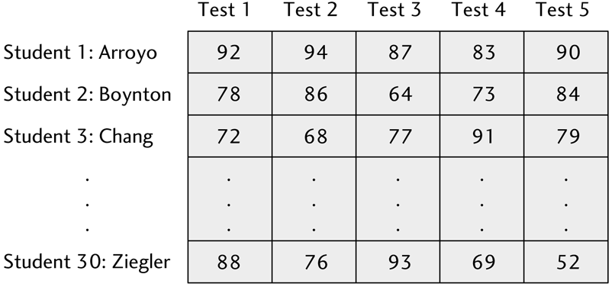
Example: A Two-Dimensional Array
A two-dimensional array is like a matrix or an electronic spreadsheet
Two factors can be, for example, Row and Column or Test Number and Student
In the example below, Boynton’s (Student #2) scores can be referenced as: Score[1,0], Score[1,1], Score[1,2], Score[1,3], Score[1,4]
Notice the ‘1’ subscript for Boynton remains constant, while the subscript for Test changes

Slide 26
Basics of Two-Dimensional Arrays
1 Declare ArrayA[10,20] As Integer
2 Declare ArrayB[20] As Integer
3 Declare FirstPlace As Integer
4 Set FirstPlace = 5
5 Set ArrayA[FirstPlace,10] = 6
6 Set ArrayB[7] = ArrayA[5,10]
7 Write ArrayA[5,2 * FirstPlace]
8 Write ArrayB[7]
The assignment statement on line 5 sets ArrayA[5,10] equal to 6. In other words, the value of the 6th row, 11th column of ArrayA is equal to 6.
The assignment statement on line 6 sets ArrayB[7] equal to the value of ArrayA[5,10], which is a 6. So now the value of the 8th element in ArrayB = 6.
The Write statements on lines 7 and 8 display the value of the element in the 6th row, 11th column of ArrayA and the value of the 8th element of ArrayB so the number 6 will be displayed twice.

Slide 27
Use Nested Loops to Load a Two-Dimensional Array
1 Declare Scores[30,5] As Integer
2 Declare Student As Integer
3 Declare Test As Integer
4 For (Student = 0; Student < 30; Student++)
5 Write “Enter 5 test scores for student “ + (Student + 1)
6 For (Test = 0; Test < 5; Test++)
7 Input Scores[Student,Test]
8 End For(Test)
9 End For(Student)

Slide 28
Use Nested Loops to Display the Contents of a Two-Dimensional Array
Write “Enter the number of a student, and
his or her test scores will be
displayed.”
2 Input Student
3 For (Test = 0; Test < 5; Test++)
4 Write Scores[Student – 1,Test]
5 End For

Slide 29
Example: Input names and 5 test scores for a class of students into a 2-dimensional array using a sentinel-controlled loop. Display the contents of the array using the count from the input to know exactly how many student records should be displayed.
1 Declare Names[30] As String
2 Declare Scores[30,5] As Integer
3 Declare Count, Test, K, J As Integer
4 Declare StudentName As String
5 Declare Sum, Average As Float
6 Set Count = 0
7 Write “Enter a student’s name; enter * when done.”
8 Input StudentName
9 While StudentName != “*”
10 Set Names[Count] = StudentName
11 Write “Enter 5 test scores for “ + Names[Count]
12 Set Test = 0
13 While Test < 5
14 Input Scores[Count,Test]
15 Set Test = Test + 1
16 End While(Test)
17 Set Count = Count + 1
18 Write “Enter a student’s name; enter * when done.”
19 Input StudentName
20 End While(StudentName)
21 Set K = 0
22 While K <= Count – 1
23 Set Sum = 0; Set J = 0
24 While J < 5
25 Set Sum = Sum + Scores[K,J]
26 Set J = J + 1
27 End While(J)
28 Set Average = Sum/5
29 Write Names[K] + “: “ + Average
30 Set K + K + 1
31 End While(K)

